Slide 1
Cancer detection using CNN and LSTM
Student Name: VIGNESH S
Register Number: 813821104118
College Name : Saranathan college of engineering
Department : Computer science and engineering
E-mail : vickyselvaraj977@gmail.com

Slide 2
Cancer detection using CNN and LSTM
This project aims to develop a deep learning model for cancer detection utilizing Convolutional Neural Networks (CNN) and Long Short-Term Memory (LSTM) networks.
The CNN component will be employed for feature extraction from medical imaging data, while LSTM will be utilized to capture temporal dependencies in patient data.
By combining these two architectures, the model will provide enhanced accuracy in detecting cancerous patterns in medical images and patient histories. The project will involve data preprocessing, model development, training, and evaluation using relevant datasets, with a focus on improving early detection and prognosis of cancer.

Slide 3


AGENDA
PROBLEM STATEMENT
PROJECT OVERVIEW
END USERS
SOLUTIONS
NEW ADD-ONS
MODELLING
RESULTS
3/21/2024 Annual Review

Slide 4

PROBLEM STATEMENT
Despite advancements in medical imaging technology, early and accurate detection of cancer remains a significant challenge.
This project aims to address this need by leveraging deep learning techniques, specifically Convolutional Neural Networks (CNN) and Long Short-Term Memory (LSTM) networks, to develop a robust and efficient system for cancer detection from medical images. The system will be trained on annotated datasets to learn patterns indicative of cancerous tissues and will provide real-time predictions to assist clinicians in making informed decisions about diagnosis and treatment planning.
The goal is to develop a reliable and user-friendly tool that can significantly improve the early detection and management of cancer, ultimately leading to better patient outcomes.

Slide 5

PROJECT OVERVIEW
This project aims to develop a deep learning system for cancer detection from medical images. By integrating Convolutional Neural Networks (CNN) and Long Short-Term Memory (LSTM) networks, the system will analyze images to identify cancerous regions accurately.
Design and implement a CNN-LSTM architecture for cancer detection.
Train the model on annotated medical image datasets to learn cancerous tissue patterns.
Develop a user-friendly interface for clinicians to interact with the system.
A CNN-LSTM model capable of accurately detecting cancerous regions in medical images.
Improved diagnostic accuracy and efficiency compared to manual interpretation.
A user-friendly interface enabling seamless integration into clinical workflows.

Slide 6

WHO ARE THE END USERS ?
Clinicians and Radiologists: They are the primary end users who would utilize the system for interpreting medical images and making diagnostic decisions
Medical Researchers: Researchers in the field of oncology and medical imaging would also be end users. They may use the system for analyzing large datasets of medical images to extract insights, validate findings.
Healthcare Institutions: Hospitals, clinics, and healthcare institutions would integrate the system into their diagnostic workflows. By using automated tools for cancer detection, they can potentially improve the efficiency of their diagnostic processes and provide better patient care.
Patients: Although patients may not directly interact with the system, they are indirect beneficiaries. Accurate and early detection of cancer through automated systems can lead to timely intervention, better treatment outcomes, and improved quality of life for patients.

Slide 7

YOUR SOLUTION AND ITS VALUE PROPOSTION
Our solution proposes the development of an advanced cancer detection system leveraging Convolutional Neural Networks (CNN) and Long Short-Term Memory (LSTM) networks. This system will analyze medical images, such as mammograms and MRI scans, to automatically identify cancerous regions with high accuracy and efficiency.
Key Components of the Solution:
CNN-LSTM Architecture
Training on Annotated Datasets
User-Friendly Interface
Value Proposition:
Improved Diagnostic Accuracy: By automating the process of cancer detection using advanced deep learning techniques, our system offers higher accuracy compared to traditional manual interpretation methods
Early Detection and Timely Intervention: Early detection of cancer is crucial for successful treatment outcomes.

Slide 8

THE WOW IN YOUR SOLUTION
1.Cutting-Edge Algorithmic Approaches:Our solution leverages state-of-the-art deep learning architectures, including Convolutional Neural Networks (CNNs) and Recurrent Neural Networks (RNNs), Long short-term memory (LSTM), meticulously fine-tuned and optimized to achieve exceptional levels of accuracy and precision in classifying biomedical text publications.
2.High-Performance Computing Infrastructure:Powered by high-performance computing resources, our solution delivers blazingly fast processing speeds, enabling real-time classification of large-scale biomedical datasets with unparalleled efficiency and scalability.
3.Dynamic Model Adaptation: Through continuous monitoring and dynamic model adaptation techniques, our solution autonomously evolves and adapts to changing research landscapes, ensuring sustained accuracy and relevance over time, even in the face of evolving cancer research trends.
4.Seamless Integration with Existing Workflows: Engineered for seamless integration with existing research and clinical workflows, our solution seamlessly integrates into users' environments, augmenting their capabilities and enhancing productivity without disrupting established processes or workflows
3/21/2024 Annual Review

Slide 9
MODELLING
Data Preparation:
Acquire a dataset of medical images (e.g., mammograms, MRI scans) with annotated cancerous regions.
Split the dataset into training, validation, and test sets.
Preprocessing:
Resize the images to a uniform size to facilitate processing.
Normalize pixel values to a common scale (e.g., [0, 1]).
Apply data augmentation techniques such as rotation, flipping, and zooming to increase dataset diversity and improve model generalization.
CNN-LSTM Architecture:
CNN Component:
Stack multiple convolutional layers followed by max-pooling layers to extract spatial features from the images.
Utilize architectures such as VGG, ResNet, or Inception for feature extraction.
LSTM Component:
Feed the output of the last convolutional layer into an LSTM layer to capture temporal dependencies.
Configure the LSTM layer to process the sequence of feature vectors extracted by the CNN
Evaluation:
Evaluate the trained model on the test set using metrics such as accuracy, precision, recall, F1-score, and area under the ROC curve (AUC-ROC).
Generate confusion matrices to assess the model's performance in detecting cancerous and non-cancerous regions.

Slide 10
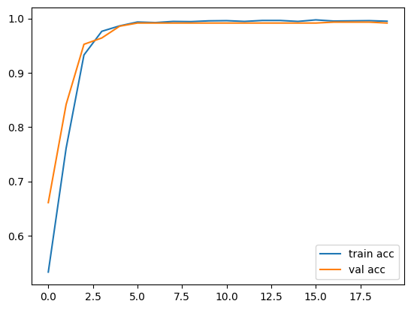
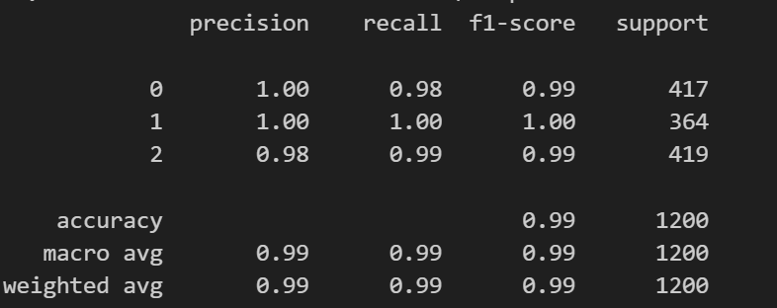
RESULTS

Slide 11
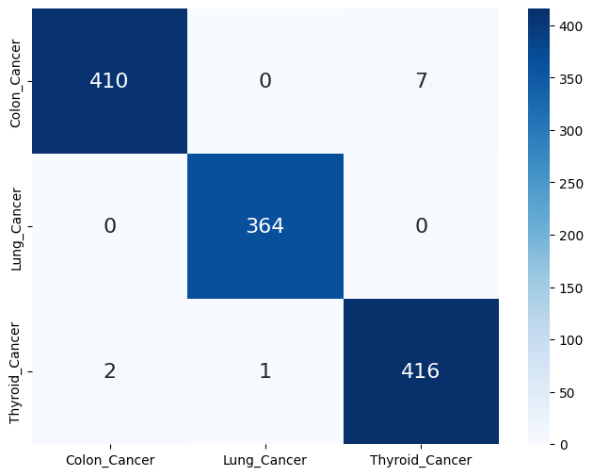
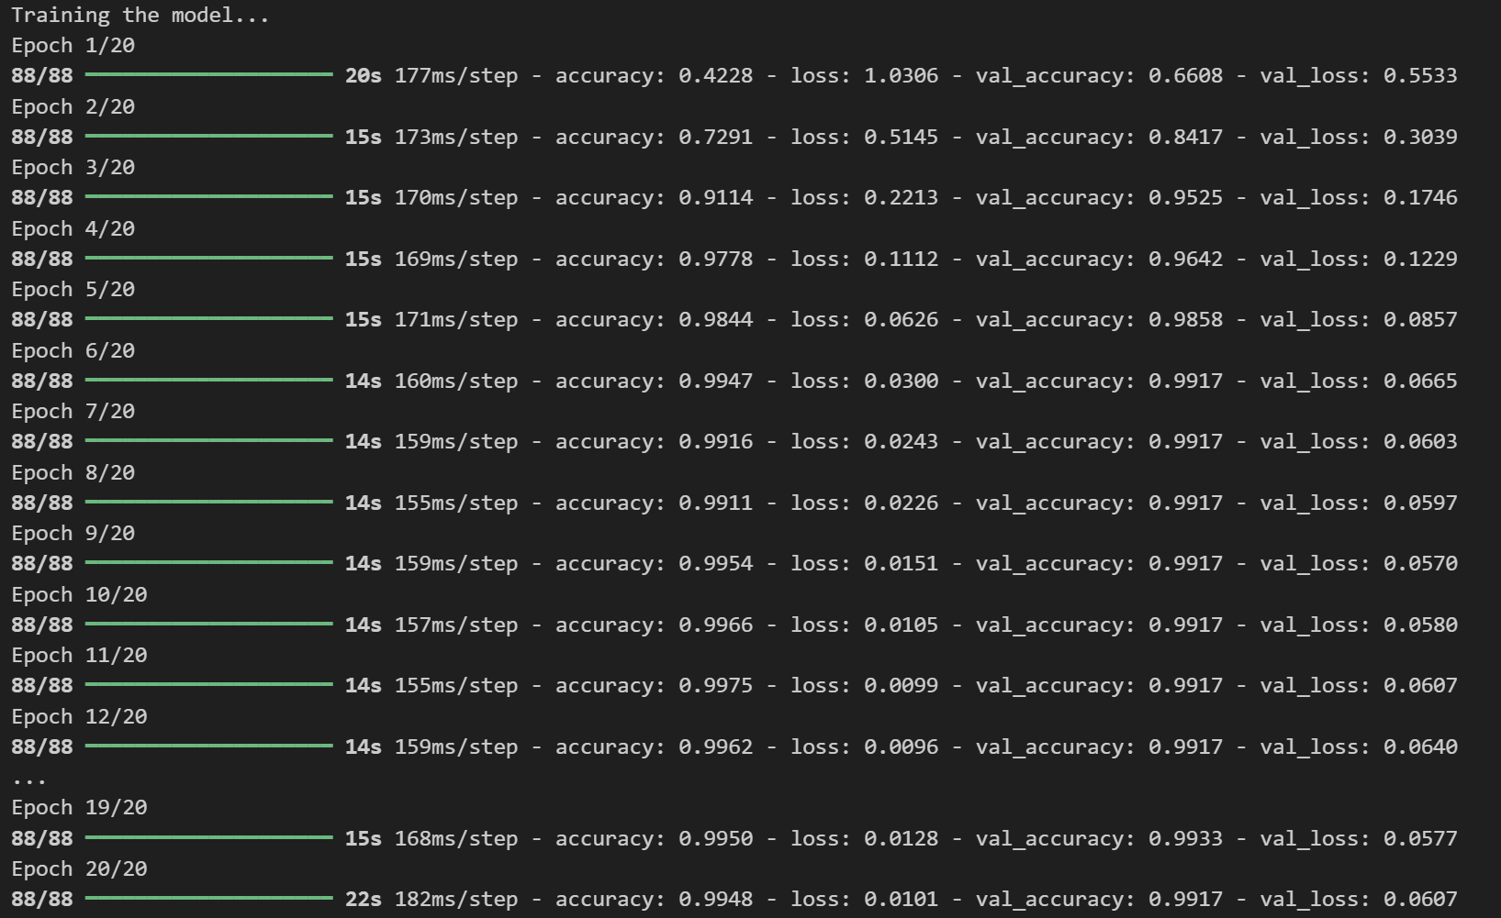
RESULTS
Demo Link

Slide 12
Conclusion In conclusion, the developed models, including Convolutional Neural Networks (CNNs) and Long Short-Term Memory (LSTM) networks, exhibit strong performance in classifying biomedical text publications pertaining to different cancer types. Through meticulous data preprocessing, feature engineering, and model selection, we have constructed robust frameworks capable of accurately categorizing diverse research articles into specific cancer categories.

